Slide 1
SMART DUSTBIN
Mini Project
Sameeksha Deshapande 1NH24EC131
Sneha 1NH24EC147
Guided By
Mr. Harish Hanchinal
Senior Assistant Professor
Dept. of ECE
New Horizon College of Engineering, Bengaluru

Slide 2
Contents
Introduction
Literature Review
Existing System
Problem Statement & Objectives
Proposed System
Block Diagram
Hardware & Software Specification
References
Progress Work
Milestones/Schedule

Slide 3
Introduction
Manual waste sorting is a major bottleneck that this automated "Smart Dustbin" resolves at the source.
The system uses moisture sensors and servo motors to intelligently detect and sort wet and dry refuse.
This scalable solution reduces human error, streamlines recycling, and promotes sustainability in smart cities.

Slide 4
Literature Review
Title of the paper | Author & Year of Publication | Outcome | Limitation
SMART GARBAGE SYSTEM USING IOT | NAVGHNE ET AL(2016) | Implemented real-time monitoring using ultrasonic and GSM for instant alert | High power consumption and dependency on a continuous internet connection

Slide 5
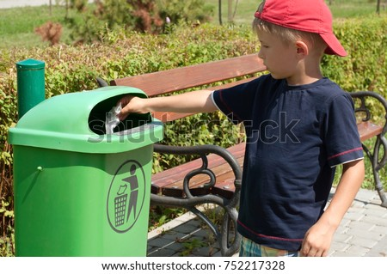
Existing System
Manual Sorting: Relies on human effort at the source or collection centres, creating a major process bottleneck.
Passive Design: Conventional bins lack sensors and cannot distinguish between waste types.
Human Error: Efficiency is strictly dependent on individual awareness and consistent disposal habits.
Poor Hygiene: Fixed openings lead to odour issues and require physical contact to operate.

Slide 6
Problem Statement & Objectives
Problem Statement
Manual waste sorting and lack of real-time monitoring hinder recycling efficiency, posing health risks and causing unsanitary urban overflows.
Objectives
Auto-Sorting: Sensors automatically separate wet and dry waste.
Touchless Lid: Ultrasonic sensors enable hygienic, hands-free operation.
Pure Recycling: Prevents waste contamination to boost processing efficiency.
Budget Prototype: A low-cost, scalable model for smart city use

Slide 7
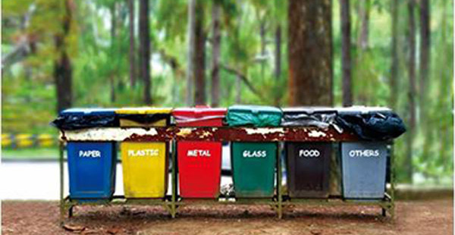
Proposed System
Automated Sorting: Integrates an Arduino Uno with moisture and ultrasonic sensors to detect waste types and user proximity for hands-free disposal.
Intelligent Actuation: Utilizes servo motors to mechanically tilt a segregation flap, ensuring waste is accurately directed into dedicated wet or dry compartments.
This Photo by Unknown Author is licensed under CC BY-SA-NC

Slide 8
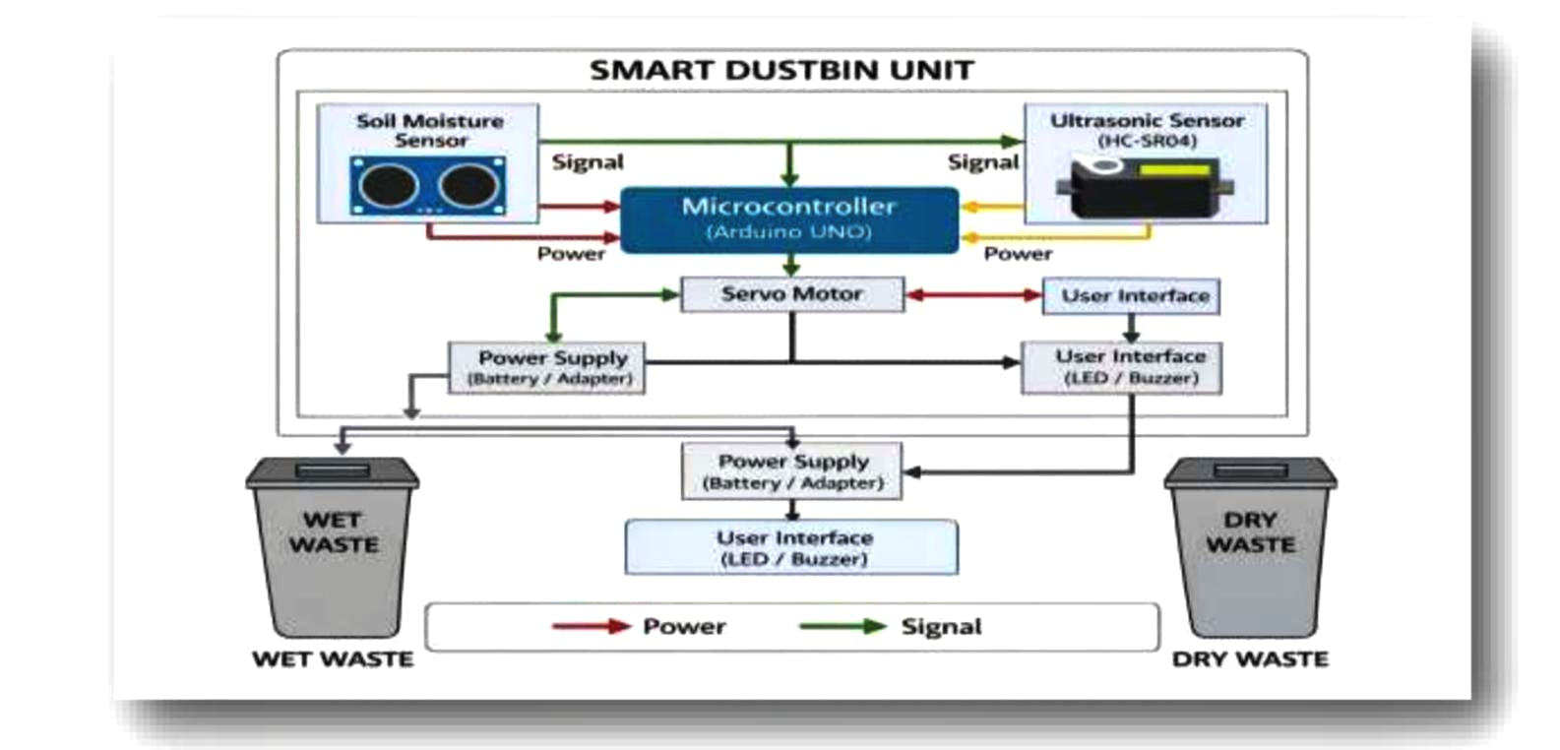
Block Diagram

Slide 9
Hardware & Software Specification
Hardware Requirements
Microcontroller: Arduino Uno (ATmega328P) for central processing.
Ultrasonic Sensor (HC-SR04): For human detection and automated lid opening.
Moisture Sensor: To detect waste water content for segregation.
Actuators: SG90/MG995 Servo Motors to control the lid and segregation flap.
Power Supply: 9V Battery or 5V DC Adapter.
Miscellaneous: Jumper wires, Breadboard/PCB, and bin chassis.
Software Requirements
IDE: Arduino IDE for coding and uploading.
​Language: Embedded C / C++.​
​Operating System: Windows 10/11

Slide 10
References
1. Kumar, S., & Sharma, A., “Smart Waste Management System Using IoT,” International Journal of
Engineering Research and Technology (IJERT), Vol. 8, Issue 4, 2019.
2. Navghane, S. S., Killedar, M. S., & Rohokale, V. M., “IoT Based Smart Garbage and Waste Collection Bin,” International Journal of Advanced Research in Electronics and Communication Engineering
(IJARECE), Vol. 5, Issue 5, 2016.
3. Shah, R., & Jain, S., “Automatic Waste Segregation System Using Arduino,” International Journal of
Scientific Research in Computer Science, Engineering and Information Technology, 2018.
4. Arduino Official Documentation, “Arduino UNO Board,” Available: https://www.arduino.cc
(Use as a reference for hardware and programming details)
5. Patil, M. S., & Patil, R. S., “Waste Segregation Using Sensors,” International Journal of Innovative
Research in Science, Engineering and Technology (IJIRSET), Vol. 7, Issue 6, 2018.
6. Central Pollution Control Board (CPCB), Government of India, “Solid Waste Management Rules,” 2016.

Slide 11
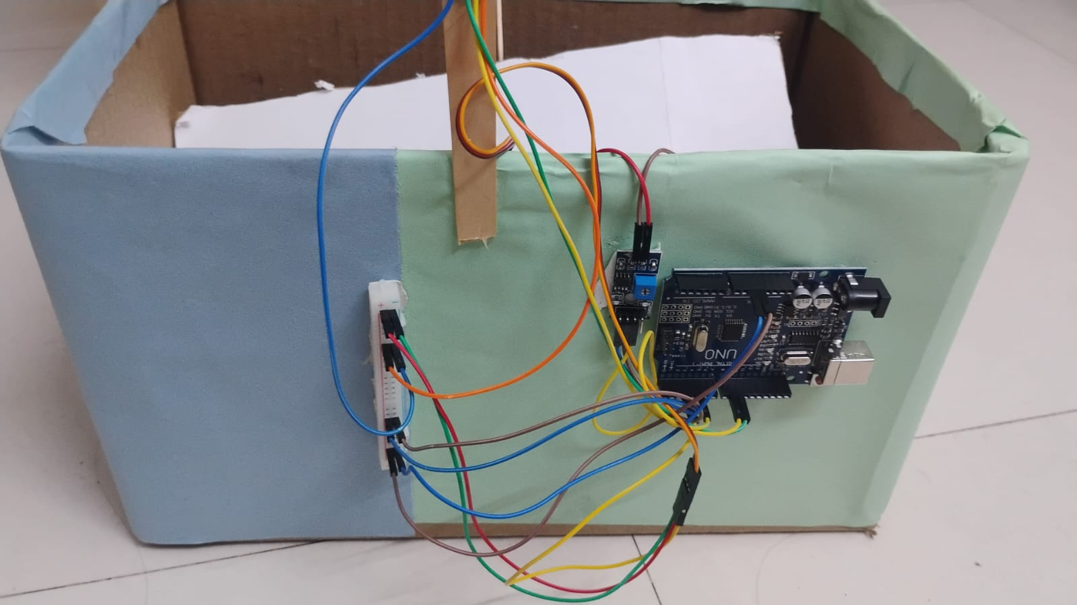
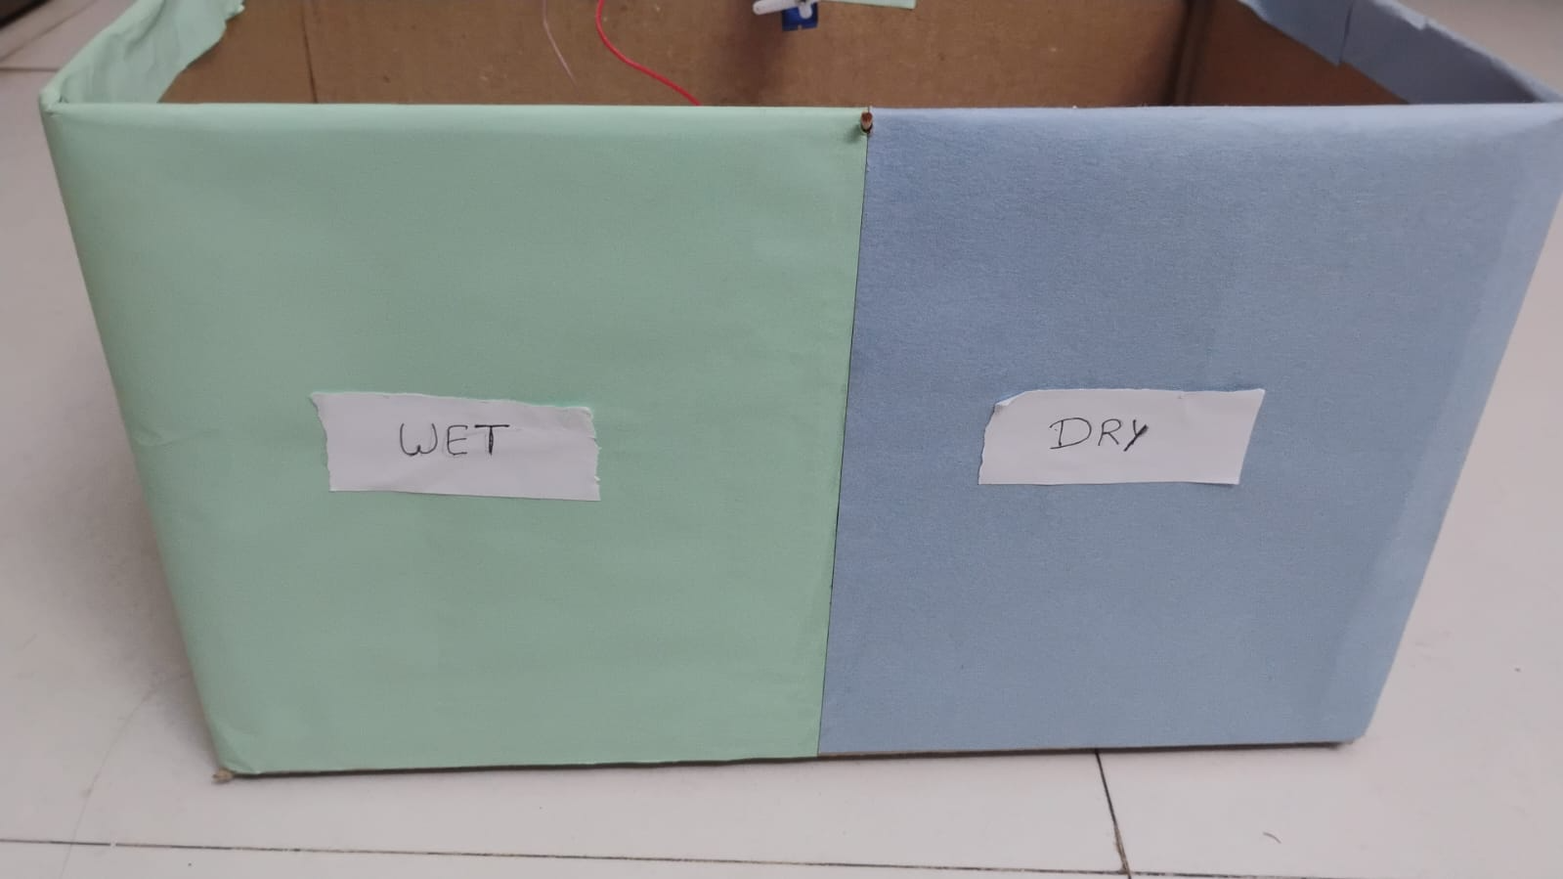
Progress Work

Slide 12
Milestones/Schedule
Milestone | Baseline Date | Target Date | Achievement
1. Literature Survey & Component Selection | 20-03-2026 | 02-04-2026 | Completed. Selected Arduino/Microcontroller, Moisture and Ultrasonic Sensor
2.System Architecture &Circuit Design | 03-04-2026 | 15-04-2026 | Completed. Finalised the block diagram pin connection for segregation logic
3.Algorithm Development &Sensor Interfacing | 16-04-2026 | 30-04-2026 | Completed. Programmed the microcontroller to read data from wet/dry sensing layers
4.Hardware Fabrication & Mechanical Setup | 01-05-2026 | 15-05-2026 | Completed. Built the physical dustbin compartments and mounted the servo motor flap
5.System Integration & Complete Testing | 16-05-2026 | 25-05-2026 | Completed. sensor thresholds and verified successful automated segregation
6.Final Documentation & Report Submission | 30-05-2026 | 02-06-2026 | In progress. Compiling the final project and presentation slides

Slide 13
Thank You

